Slide 1
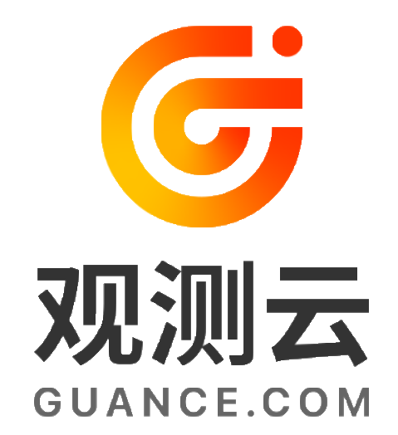
Guance Cloud: Creating an Integrated System Observability Platform for the New Era

Slide 2
CONTENTS
Guance cloud
Background
What is Guance cloud
Production advantage
Main fuctions
Conclusion

Slide 3

Background
Background
With the proliferation of cloud computing and cloud-native technologies, modern enterprises have made significant progress in the flexible deployment and management of applications. However, the rapid growth of systems and frequent updates have brought unprecedented challenges to operation and maintenance (O&M) technology systems. Especially in multi-cloud environments and diverse infrastructures, O&M, development, and testing teams have to frequently switch between different observability solutions and dashboards. This results in numerous observability blind spots, seriously threatening the digital transformation of enterprises. Guance Cloud has emerged to address these issues. As a system observability platform designed for development, O&M, testing, and business teams, it aims to provide an integrated, end-to-end solution to comprehensively enhance enterprise observability and effectively tackle the complexities of multi-cloud and multi-architecture environments.

Slide 4
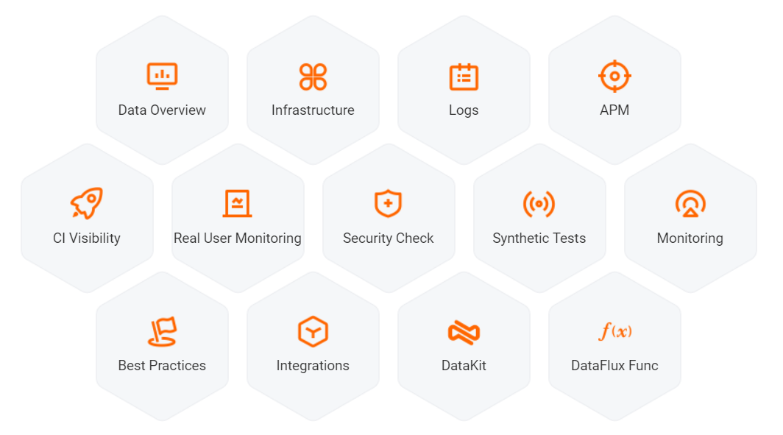
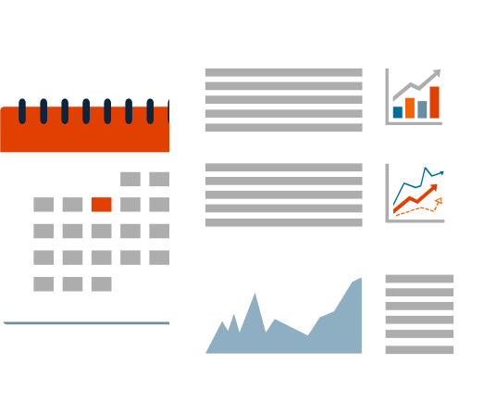
What is Guance cloud?
Guance Cloud is an integrated platform designed to solve observability issues in cloud computing and cloud-native applications. It not only monitors infrastructure but also delves into application and business layers, offering comprehensive observability services. With Guance Cloud, enterprises can achieve real-time system status monitoring, fault diagnosis, performance optimization, and security inspection, ensuring system stability and efficient operation.

Slide 5
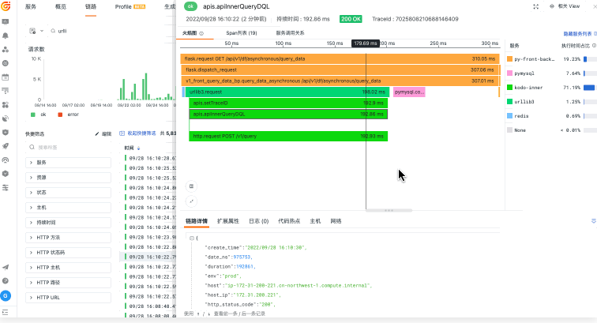
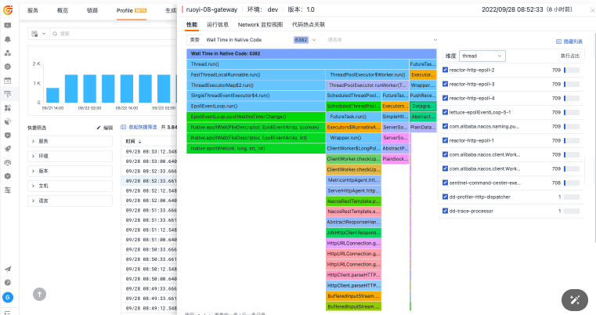
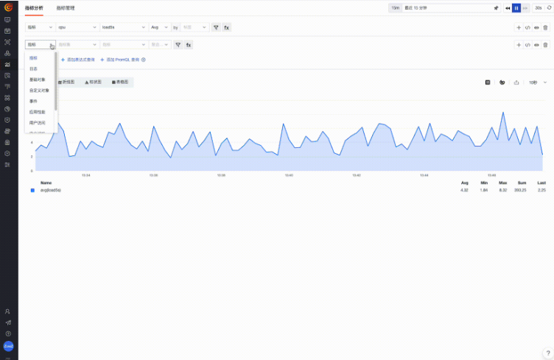
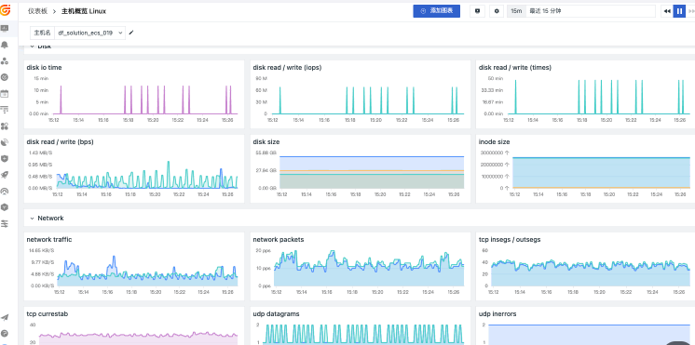
Production advantage
Guance Cloud, based on a data collection engine (DataKit), a query language (DQL), and a work platform (Guance Cloud), offers comprehensive observability services. Whether it is infrastructure monitoring, log and metrics management, application performance monitoring, user access monitoring, availability monitoring, anomaly detection, security inspection, or CI visualization, Guance Cloud provides end-to-end insights through unified data collection, storage, processing, analysis, and alerting.
Full-Stack Observability
Guance Cloud covers infrastructure, middleware, application server, and client-side monitoring, offering comprehensive monitoring from the underlying hardware to application performance, helping enterprises quickly identify and resolve issues.
Real-Time Interactive Monitoring
Guance Cloud supports flexible scene layouts and a rich selection of charts. Users can easily create custom dashboards with a drag-and-drop interface to meet real-time observability needs.

Slide 6
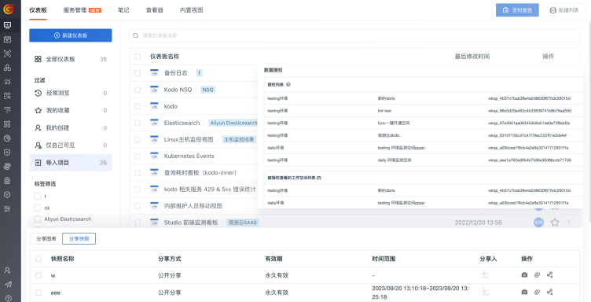
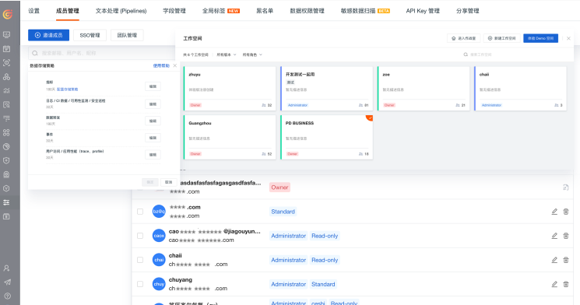
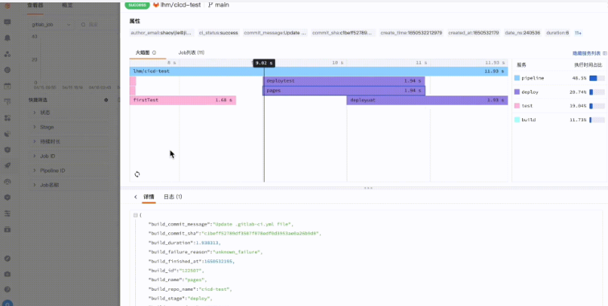
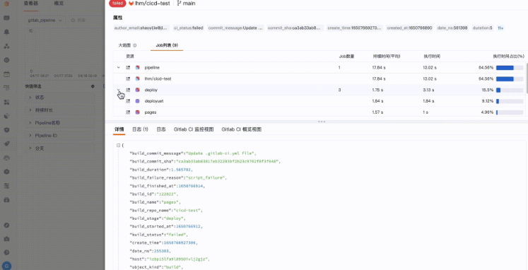
Production advantage
Guance Cloud, based on a data collection engine (DataKit), a query language (DQL), and a work platform (Guance Cloud), offers comprehensive observability services. Whether it is infrastructure monitoring, log and metrics management, application performance monitoring, user access monitoring, availability monitoring, anomaly detection, security inspection, or CI visualization, Guance Cloud provides end-to-end insights through unified data collection, storage, processing, analysis, and alerting.
Efficient Team Collaboration
Guance Cloud emphasizes team collaboration with features like anomaly alert notifications and team member management, promoting information sharing and efficient collaboration to enhance overall engineering levels.
Support for Technological Innovation
Guance Cloud supports real-time monitoring of technological deployment progress, helping teams quickly assess the impact of new technology introductions, driving continuous technological innovation and optimization.

Slide 7
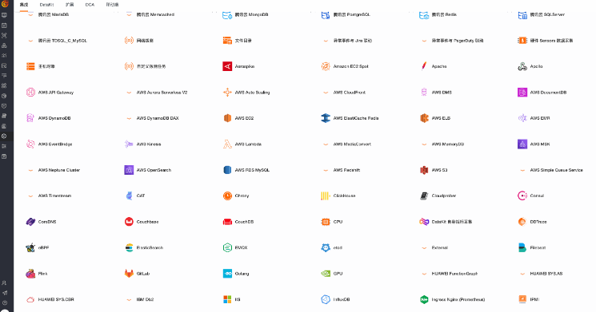
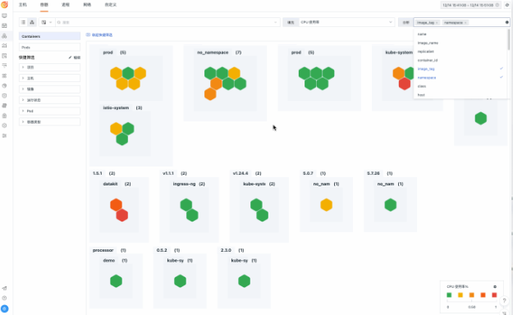
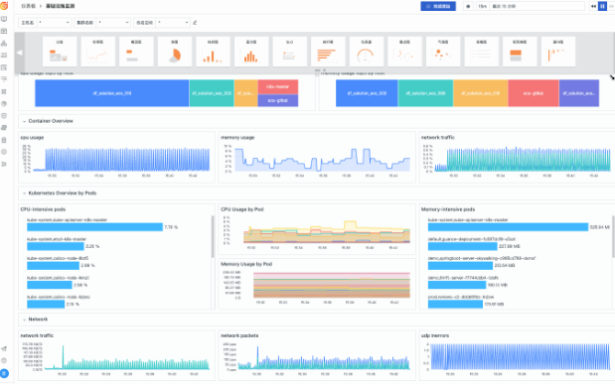
Main functions
Unified Data Collection Engine - DataKit Guance Cloud uses the DataKit data collection engine, supporting full-stack data collection and custom data collection methods. DataKit has strong cloud-native support capabilities, automatic election collection capabilities, and flexible maintenance solutions (e.g., standalone deployment, container deployment, and DaemonSet deployment), significantly simplifying data collection complexity. Through a visual management suite (DCA client), users can achieve unified collection and reporting of massive heterogeneous data sources.
Unified Monitoring of Multiple Data Sources Guance Cloud integrates various monitoring capabilities through unified data collection, storage, processing, and analysis. By installing a single DataKit, users can achieve unified access and monitoring of various devices and data, reducing O&M costs and complexity.
Custom Dashboards Guance Cloud offers powerful custom dashboard capabilities, supporting graphical components and simple builders. Users can easily create monitoring views that meet business needs. With features like linked queries, text records, drill-down, and jump, users can gain deep business insights.

Slide 8
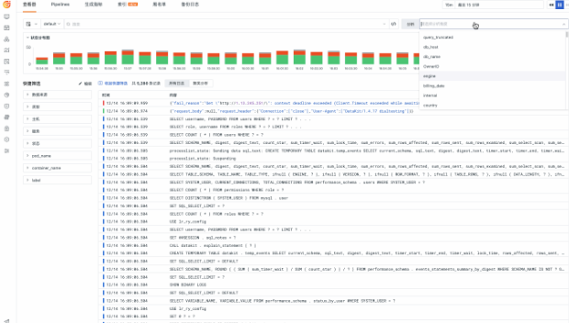
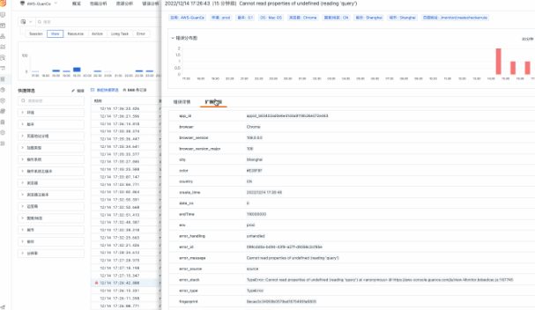
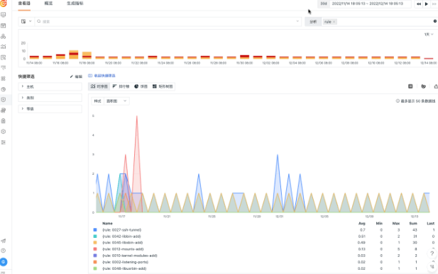
Main fuctions
Compatibility with Multi-Cloud and Technological Architectures Faced with the challenges of multi-cloud strategies and distributed systems, Guance Cloud is technology stack-neutral and cloud-neutral, compatible with various cloud environments and technological architectures. No code changes are required; all data from different clouds can be integrated into the Guance Cloud platform through standard collectors for unified observability.
DevOps Data Platform Guance Cloud is not only a system observability platform but also a unified DevOps data platform. It helps teams achieve production, delivery, assurance, and optimization of systems. Through comprehensive data collection and rich data association methods, it provides a real-time overview of applications across infrastructure, middleware, databases, application servers, and clients. It supports efficient collaboration among development, O&M, testing, and business teams, driving agile development and continuous delivery for enterprises.
Global Perspective Intelligent Security Inspection Guance Cloud provides enterprise leaders with a global view of system status. Through web or mobile apps, they can gain insights into target application performance, user experience, availability, faults, and business data anytime, anywhere. Guance Cloud’s security inspection feature uses new security scripts to periodically scan systems, software, and logs, outputting real-time inspection reports and synchronizing anomalies. It supports comprehensive security checks of servers, applications, network devices, and business systems, promptly identifying system flaws and providing security recommendations.

Slide 9
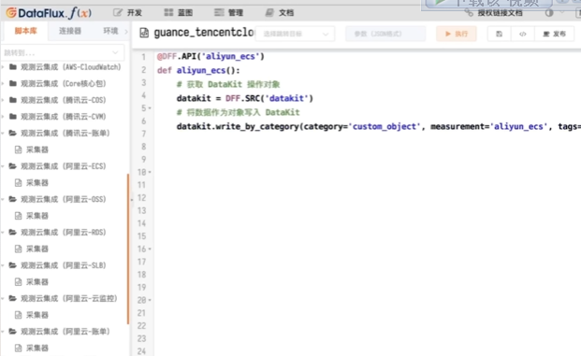
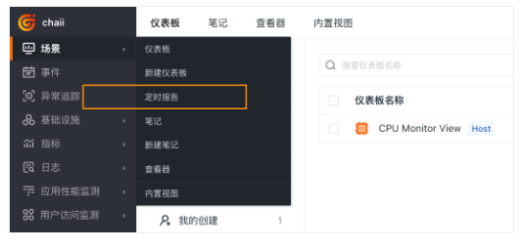
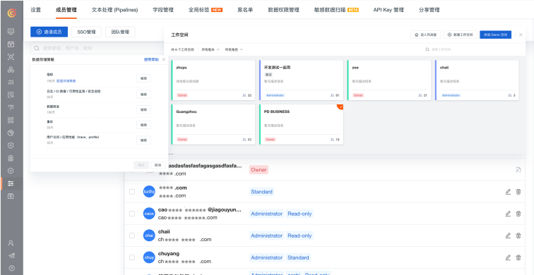
Main fuctions
Support for Data Development and Technological Innovation Guance Cloud not only has standardized monitoring capabilities but also offers powerful programmability, supporting users to customize and extend all fields for comprehensive business descriptions. Through DataKit collectors and DataFluxFunc, users can customize new toolchains to address actual needs or changes in application scenarios, promoting more efficient DevOps practices.
Efficient Team Collaboration and Information Sharing Guance Cloud emphasizes team collaboration and information sharing through features like anomaly alert notifications and team member management. Multi-workspace support provides independent work environments for cross-functional teams, enhancing the overall engineering level of enterprises.
Continuous Technological Innovation Guance Cloud supports real-time monitoring of technological deployment progress, helping teams conduct comprehensive evaluations and feedback on the introduction of new technologies. Based on comprehensive observability capabilities, Guance Cloud enables enterprises to quickly obtain feedback on technological deployments, make correct technology selections and practices, and maintain competitive advantages.

Slide 10
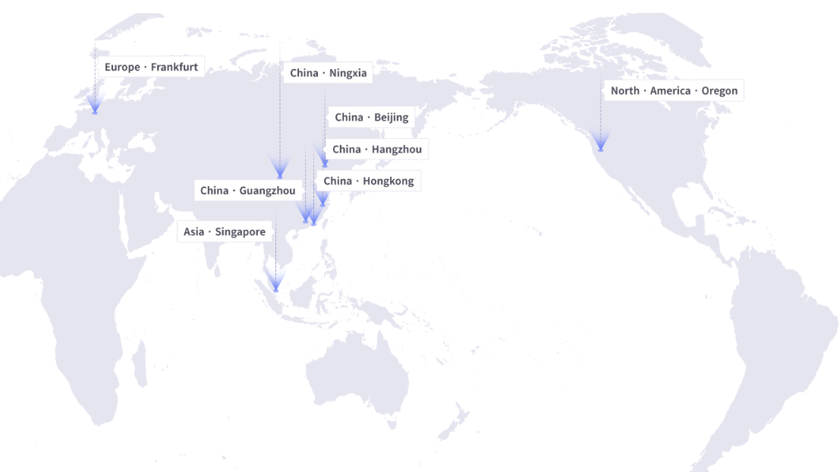
Join us
Join us
Guance Cloud is a powerful system observability platform that provides enterprises with end-to-end insights and real-time monitoring capabilities through unified data collection and monitoring capabilities. Whether addressing the challenges of multi-cloud environments or driving DevOps practices, Guance Cloud offers robust support for enterprise digital transformation. With Guance Cloud, enterprises can achieve efficient O&M, agile development, and continuous delivery, maintaining a leading position in a highly competitive market. Guance Cloud is an indispensable partner for development, O&M, and business teams in the new era.

